Slide 1


SquadUp July 2nd, 2018
Project Release Plan
Team members:
Product Owner: Zahir Yahya
Scrum Master: Sean Woods
Team: Chuangbo Tong, Shyaan Khan, Collin Fulcher, Tyler Frick

Slide 2
SquadUp
Project Release Plan
Question
Have you ever wanted to play a sport and show up to a park to find no one there?
Are you new to a city and want to find a park to play at?
Do you have no friends and want to find a group of people to play with?
High level goal
Our goal is to create a social platform for people who are interested in playing sports with one another.
This means having features that allow users to select a sports category and find nearby parks with a brief description.
For those who created an account, you have the ability to create events, form group, and more!

Slide 3
Sprint 1
Project Release Plan – User Stories
User Story | Priority | Story Points
As a guest, I want to select a sports category so that I can be matched with people who have similar interests. | 1 | 3
As a guest, I want to search for parks in my area so that I can find a park to go to. | 1 | 3
As a guest, I want to be able to create an account, so that I can have the privilege that account holders could enjoy. | 1 | 5

Slide 4
Sprint 2
Project Release Plan – User Stories
User Story | Priority | Story Points
As an account holder, I want to create groups/events so that people can decide to join. | 1 | 5
As an account holder I want to edit my group/event so that I can update my event/group with new info. | 1 | 2
As an account holder I want to message other users so that we can communicate. | 1 | 8

Slide 5
Sprint 3
Project Release Plan – User Stories
User Story | Priority | Story Points
As a guest, I want to know the number of people at the park so that I know if it is crowded or not. | 2 | 5
As a guest, I want to view the park description so that I know what kind of players and atmosphere the park has. | 2 | 2
As an account holder, I want to endorse other users so that the community knows their reputation. | 2 | 5

Slide 6
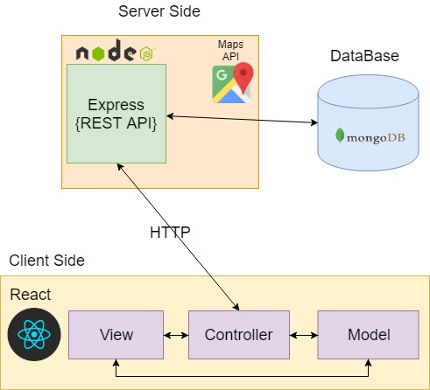
SquadUp
Project Release Plan – Architecture

Slide 7
SquadUp
Project Release Plan – Challenges/Risk
Challenge/Risk:
Design complexity of features we want to have
Some experience with web development
Learning new technologies
Making sure all team members are coordinated in efforts
Team members have different programming experiences
Possible scheduling conflicts
Only have 5 weeks, small amount of sprints

Slide 8









SquadUp
Project Release Plan – Technologies
Technology 1: Javascript, HTML, CSS, Node.js
Technology 2: Express, React, jQuery, Bcrypt, Passport, Google Places API, MongoDB
Technology 3: Github, Sublime Text, Slack, Google Drive

